Slide 1

SEC290-Week 8 Final Course Project
Luella Tracy Henderson
10/21/2023

Slide 2
Introduction
In this presentation I will go over everything that I have learned within the eight weeks of this class.
The list will be as follows:
Intrusion analysis using Wireshark
Open SSL
SNORT
Live memory analysis
Firewall
Challenges faced
Career skills
Conclusion

Slide 3
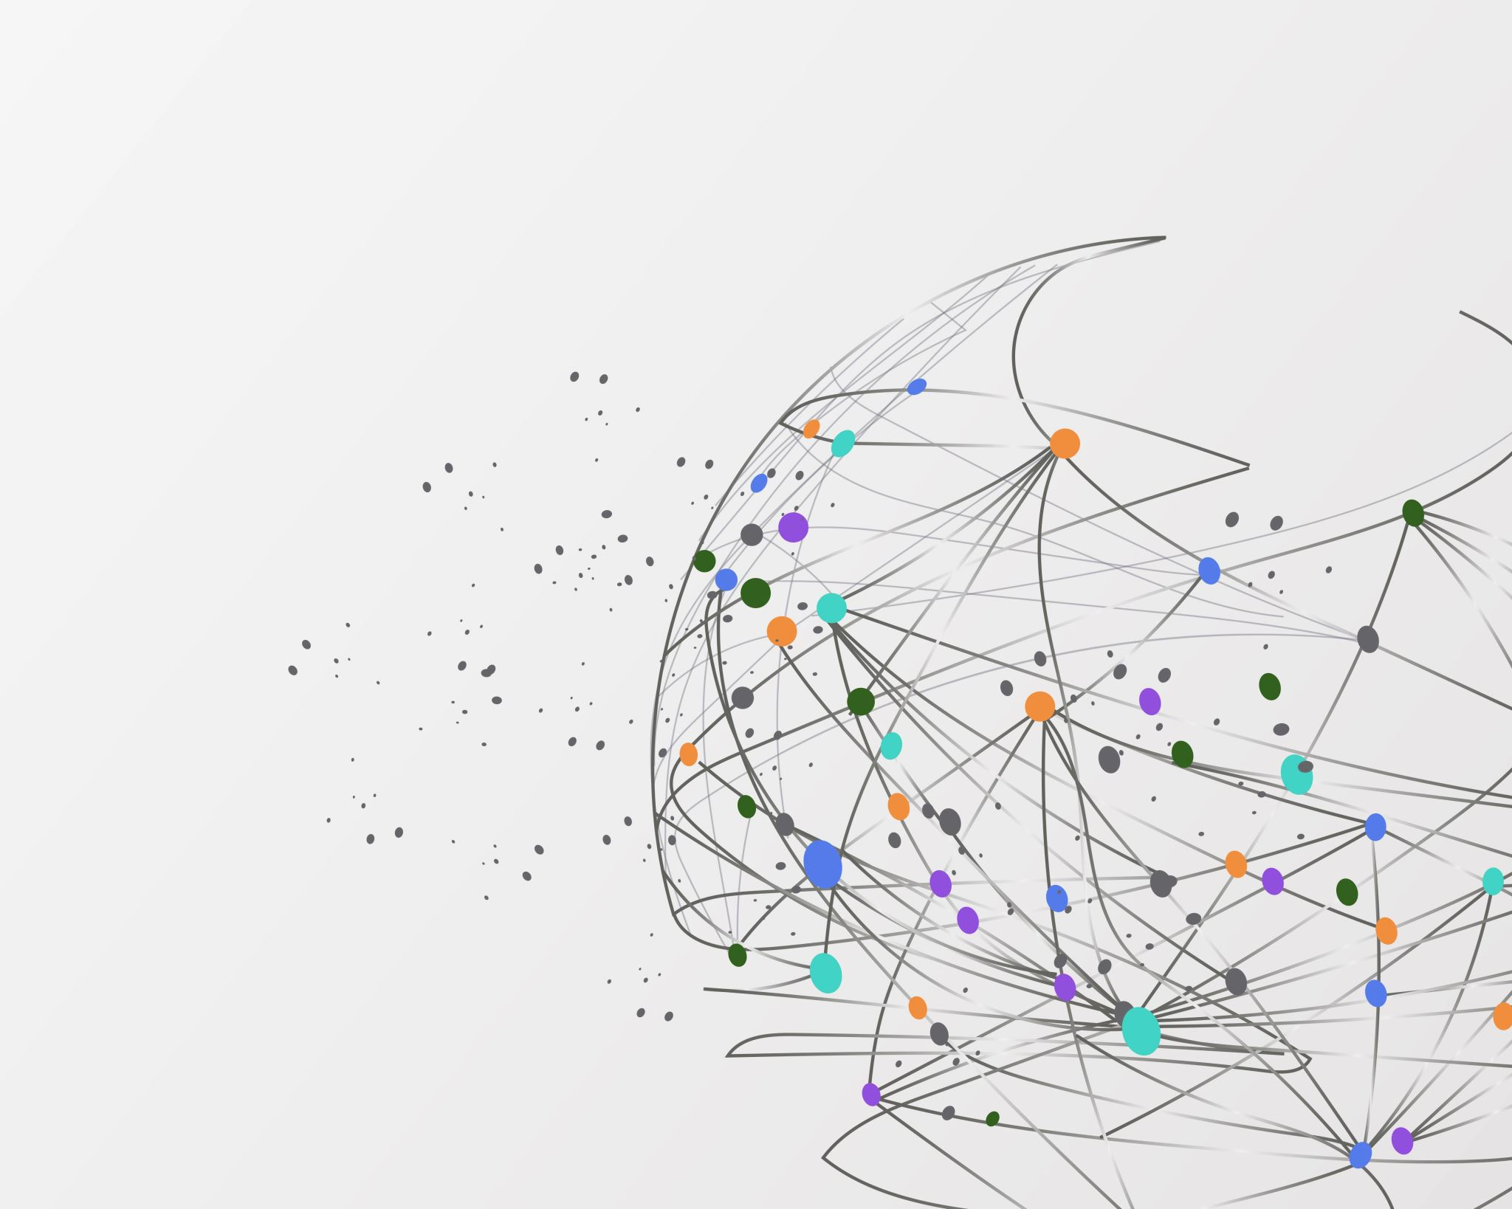
Module 2 Intrusion Analysis using Wireshark

Slide 4





Basic attack analysis
Look at captures no. 20 and 22. (You can use the “Go” link at the top of the Wireshark screen to quickly go to a specific capture) Both packets are ICMP traffic but there are subtle differences between them. Compare the time-to-live and data field sizes in the two packets. What differences do you see? The differences that I saw between the two packets were with the IP address and the pings.
Do a little Internet research to discover which operating systems use the specific values in their ping commands. What operating system generated the echo request in capture 20? The request would be generated by the ICMP. The operating system being by windows operating systems since within the description of the results it frequently displayed windows. Although at the same time it could also be generated by Linux, and Mac, depending on your system that you use.
Review packet no. 37 and beyond, what do you think is taking place here? This means that the machine is under attack/hacked.
Look at capture 22846. What is suspicious about the flag settings in this packet? For capture 22846 I think the flag settings vary from machine to machine since my results were different from the displays in the example provided.
What is the IP address of the host being targeted? 192.269.25.1 is the one being targeted.

Slide 5

References
…Ping Command Explained | Real World Example - Bing video
… How to Use the Ping Command for Testing in Windows (lifewire.com)

Slide 6
Module 3 Open SSL

Slide 7
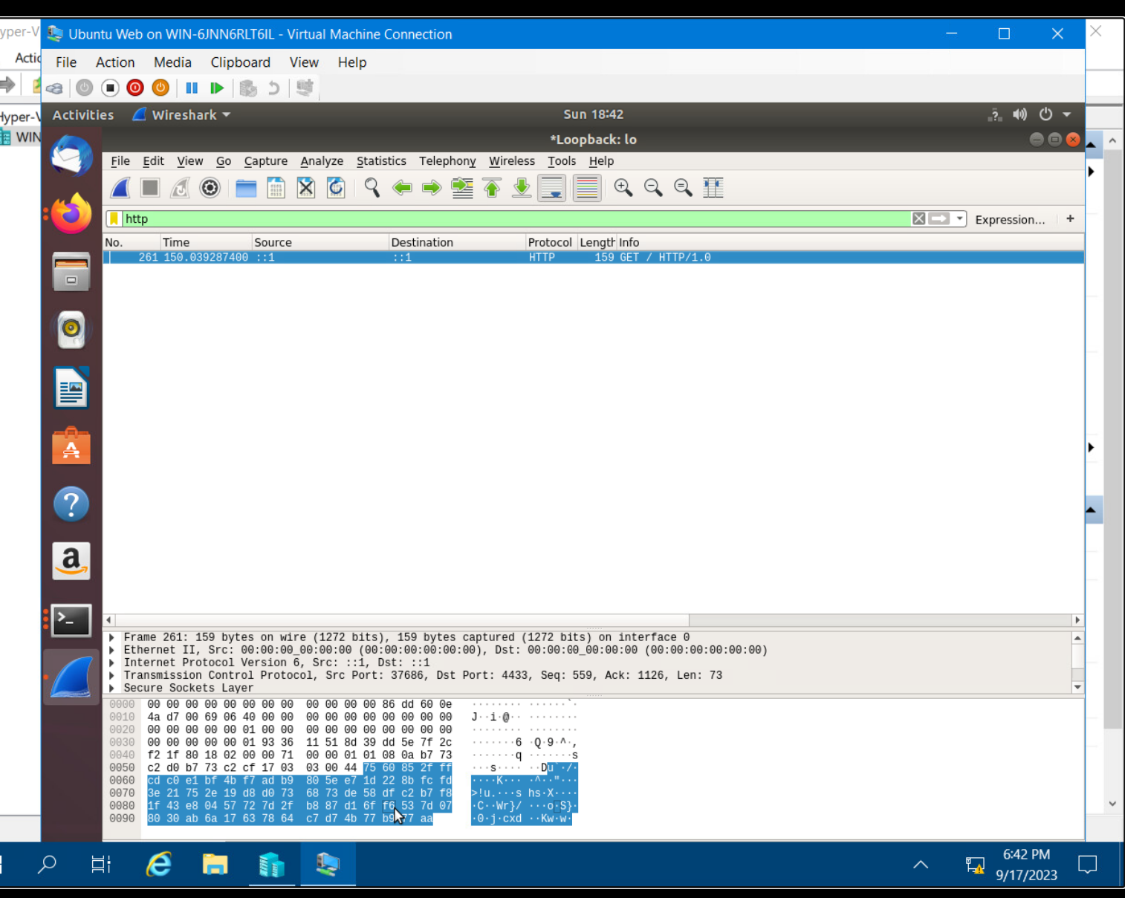
Creating and testing an SSL/TLS file
Take a screenshot of the output in Step 20.
It should show the GET request in the Info column.

Slide 8
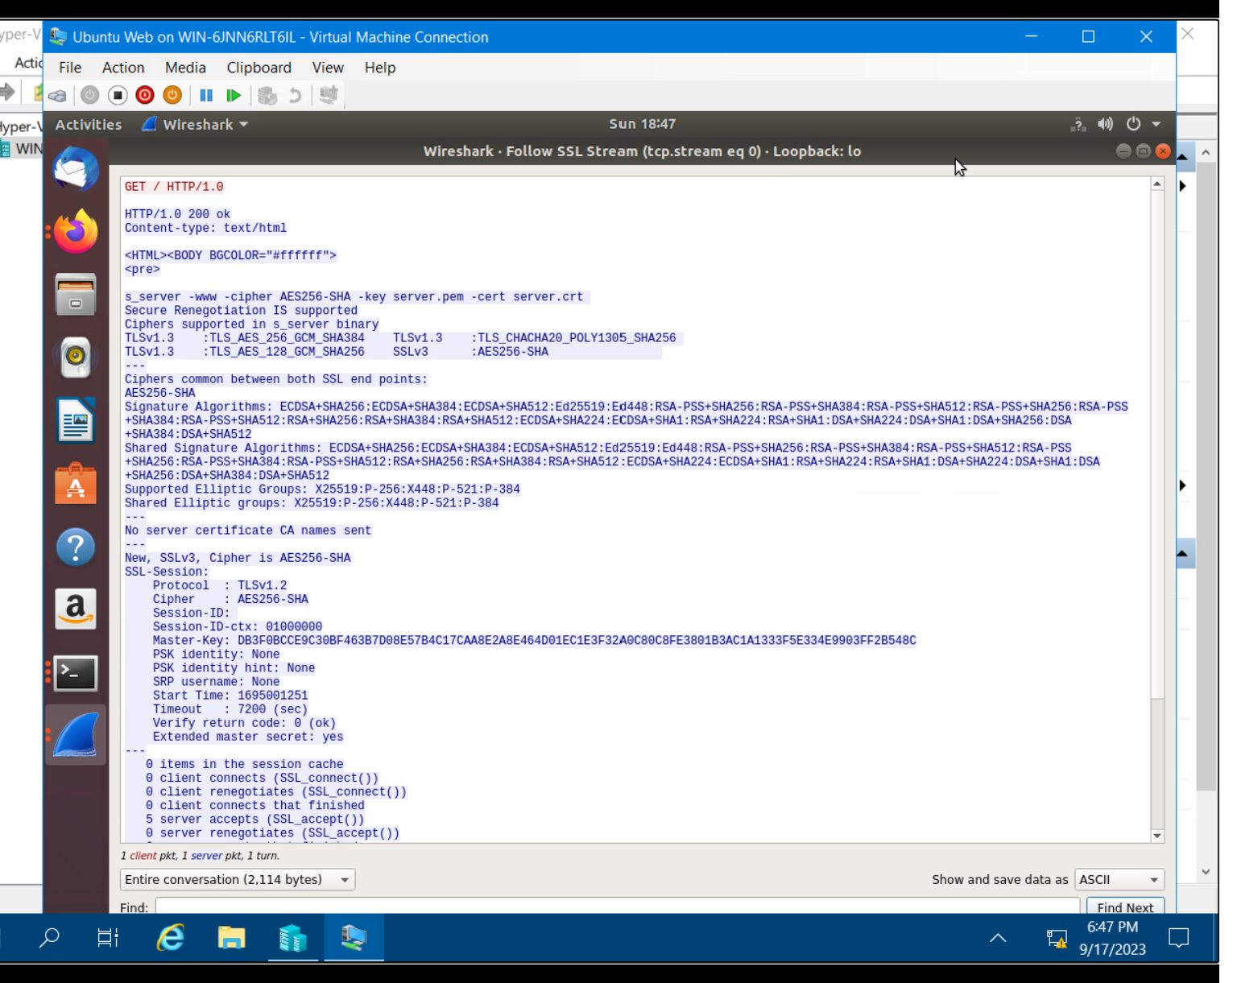
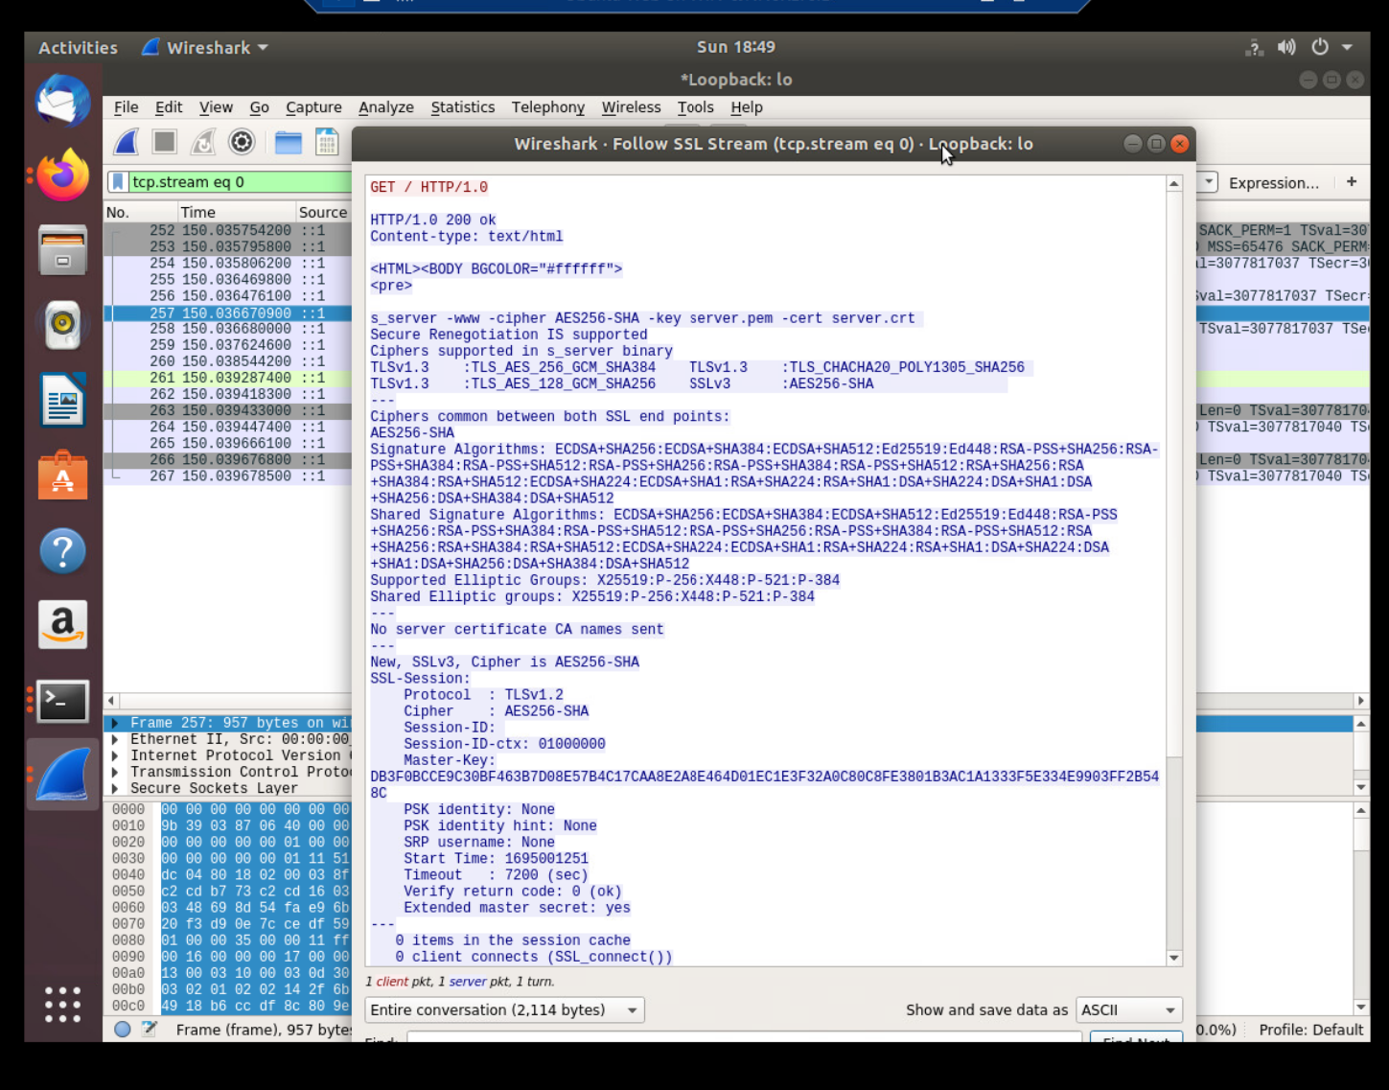
Creating and testing an SSL/TLS file cont’d
Take a screenshot of the output in Step 22.
It should show the decrypted SSL stream.

Slide 9
References
Installing a Basic SSL/TLS Certificate in nginx - YouTube
Security - Certificates | Ubuntu
DeVry Module 3 project guide video

Slide 10
Module 4 Snort

Slide 11
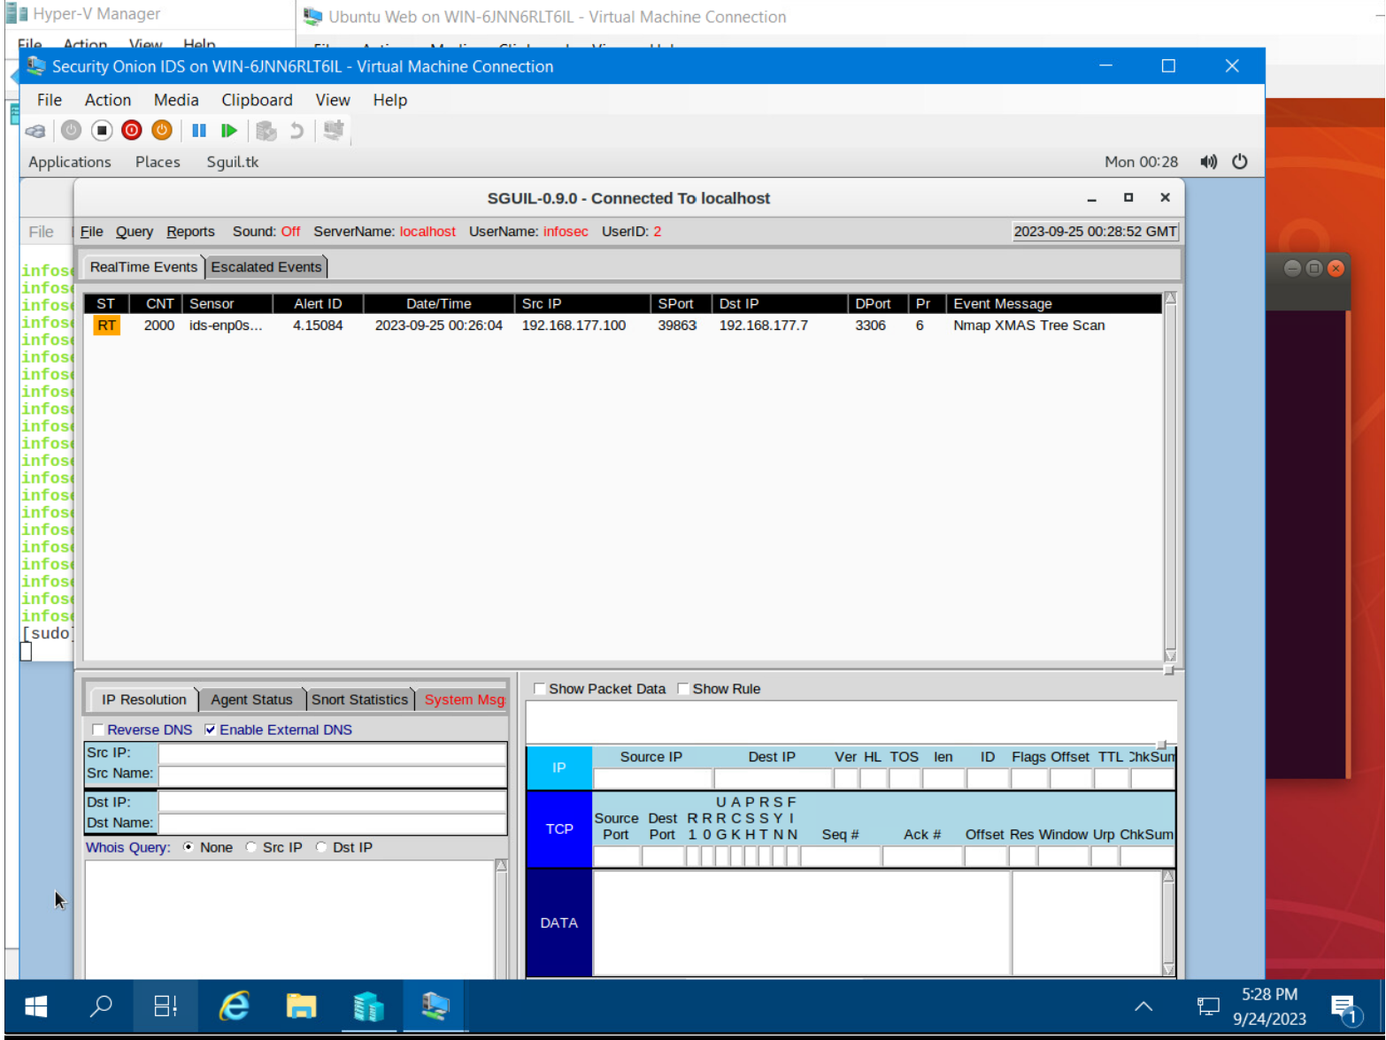
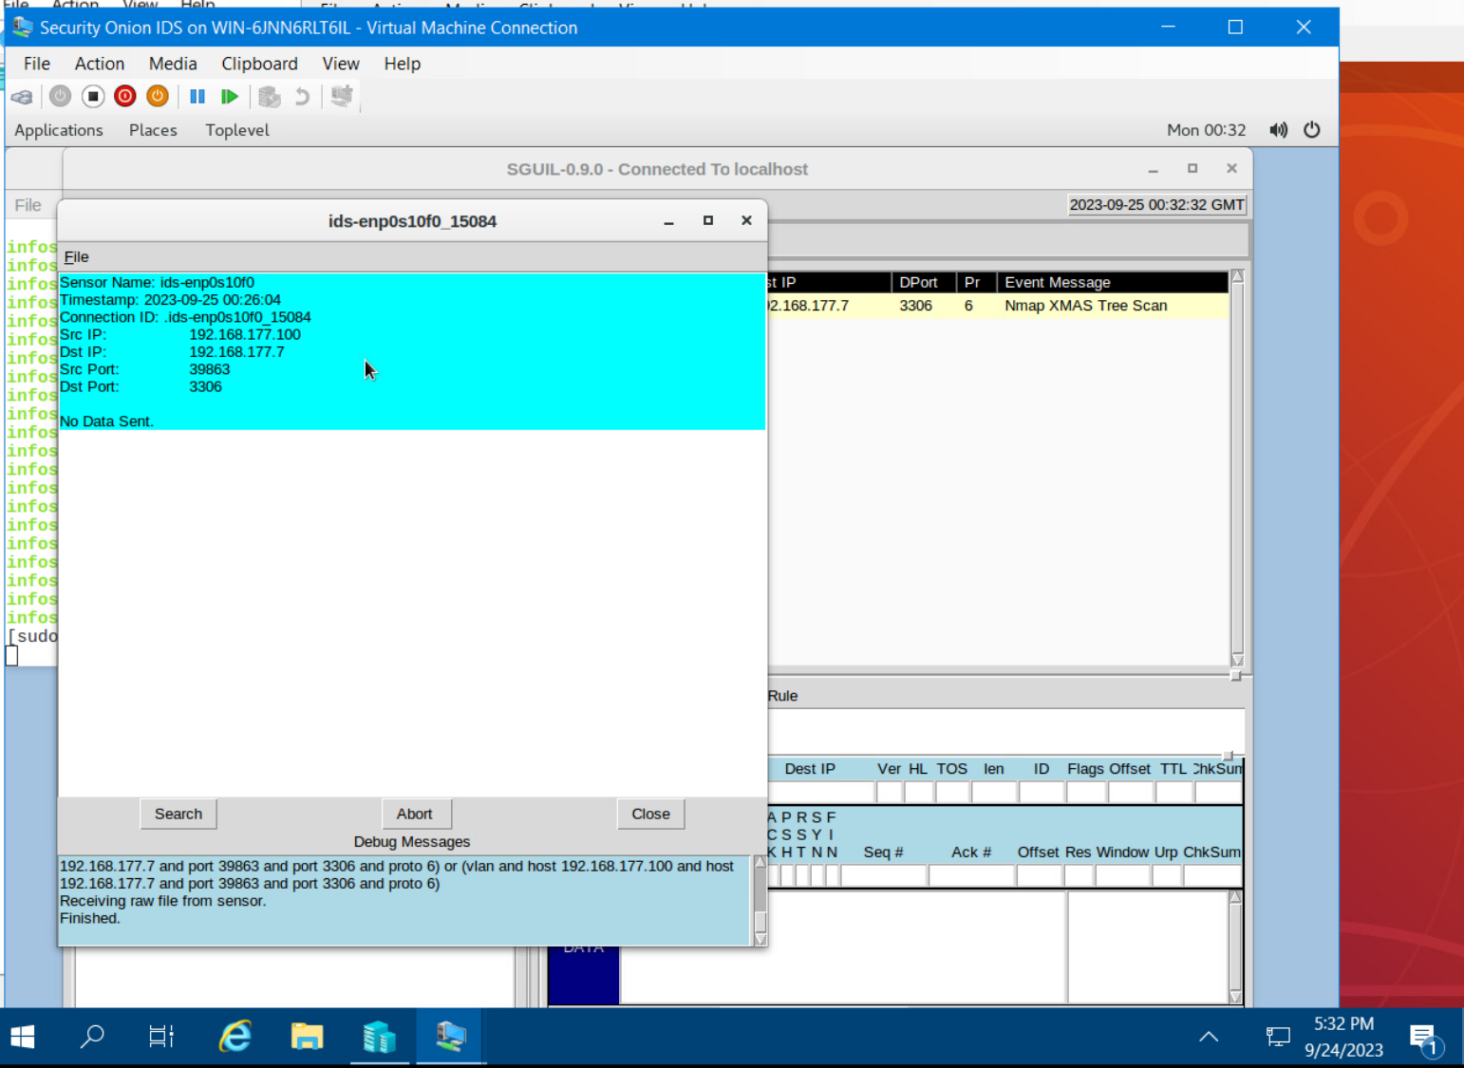
Testing Snort rules
Take a screenshot of the output in Part 1 Step 17.
It should show the transcript of the XMAS scan alert.

Slide 12
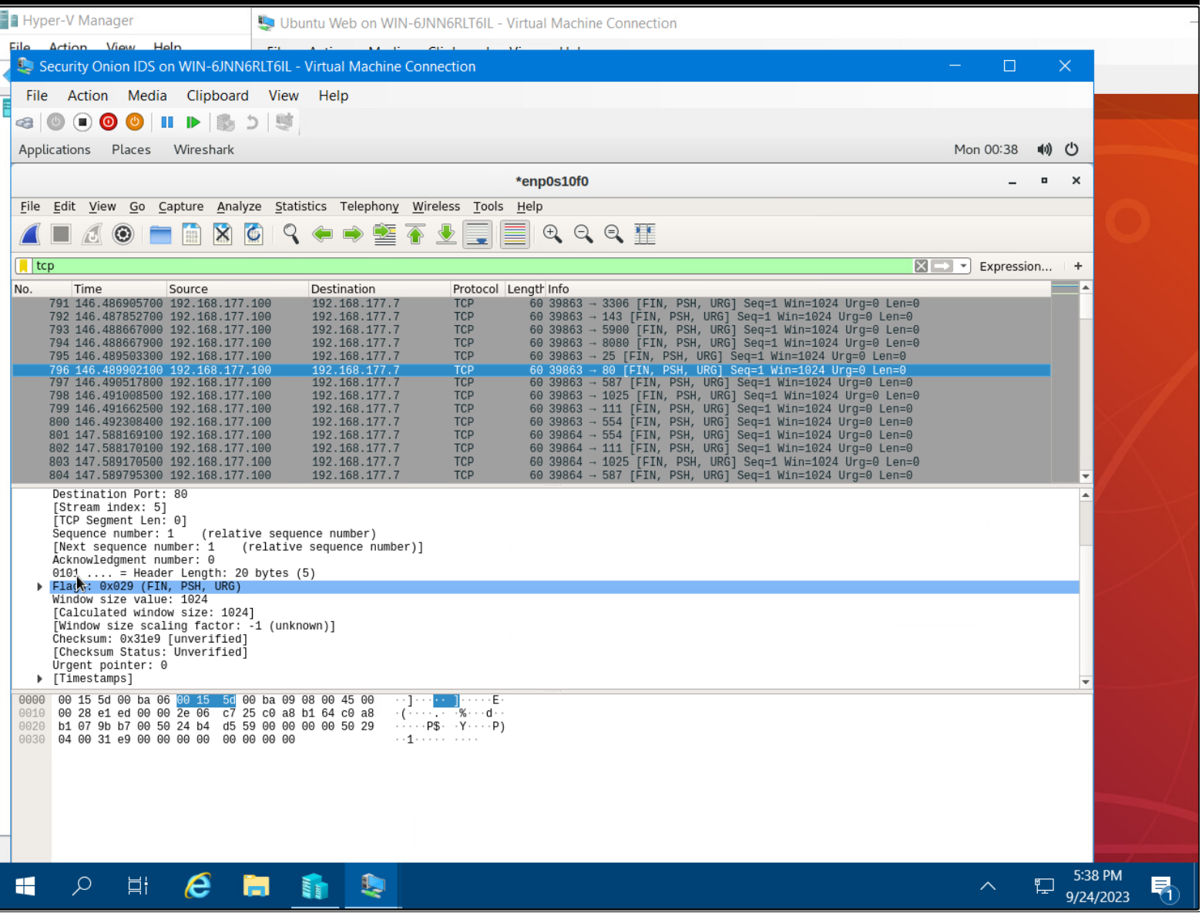
Testing Snort rules cont’d
Take a screenshot of the output in Part 1 Step 20.
It should show the TCP packets generated by the XMAS scan.

Slide 13
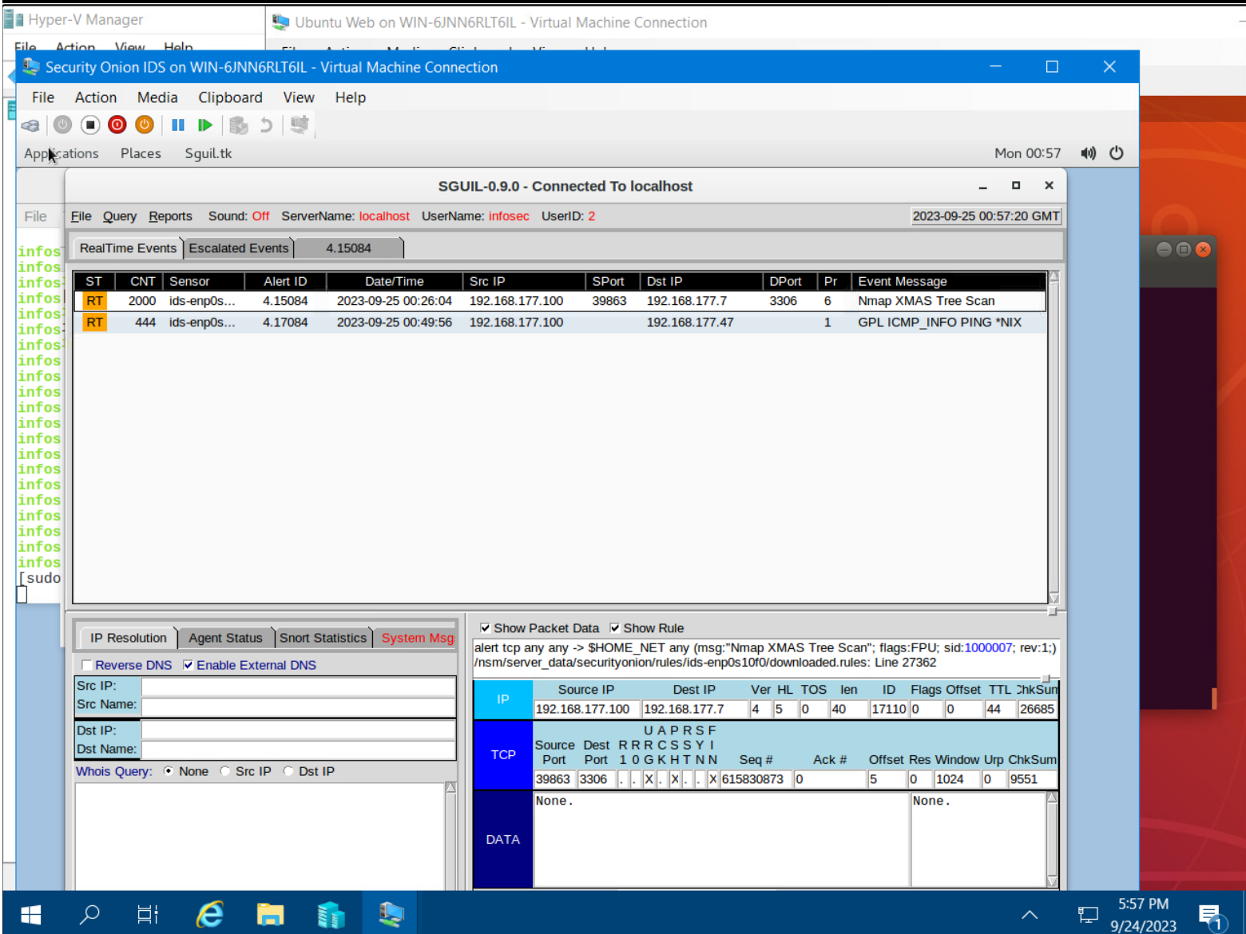
Creating Snort rules
Take a screenshot of the output in Part 2 Step 7.
It should show the ping activity alert.

Slide 14
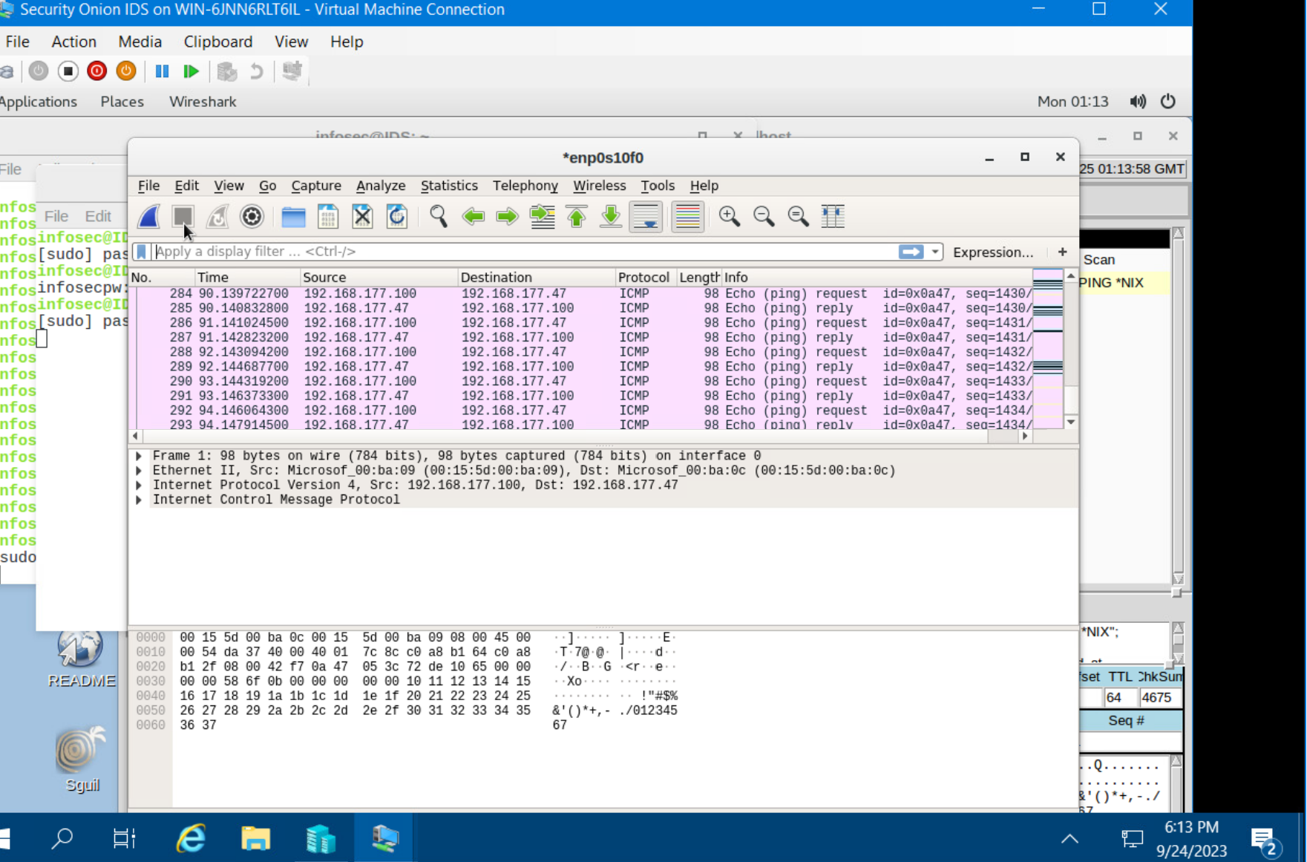
Creating Snort rules cont’d
Take a screenshot of the output in Part 2 Step 8.
show the ICMP packets generated by the ping activity.

Slide 15
Module 5 Live Memory Analysis

Slide 16
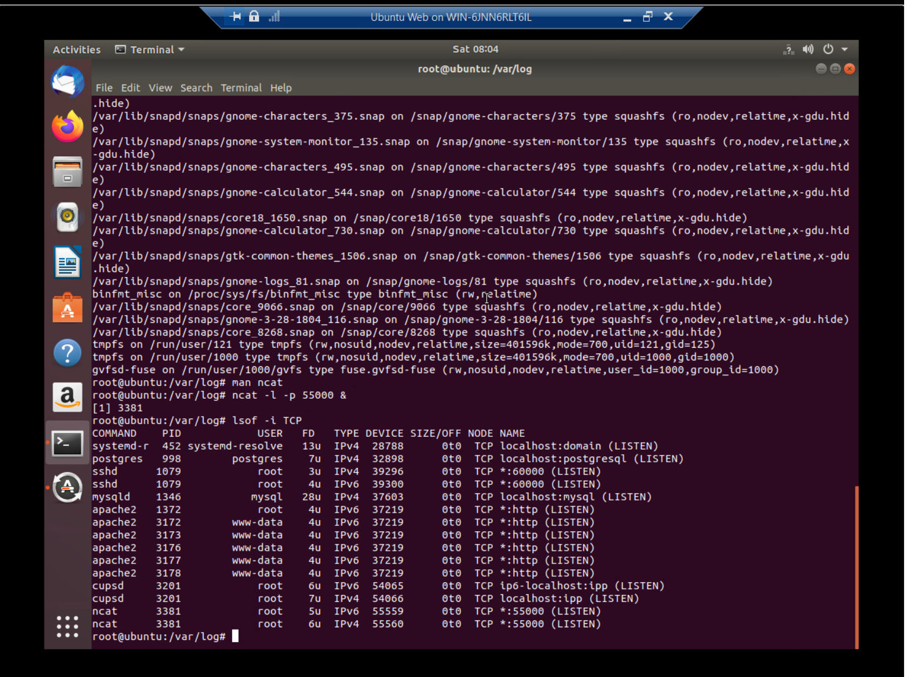
Linux Processes
Take a screenshot of the output in Part 1, Step 16.
It should show port 55000 open for both IPv4 and IPv6.

Slide 17
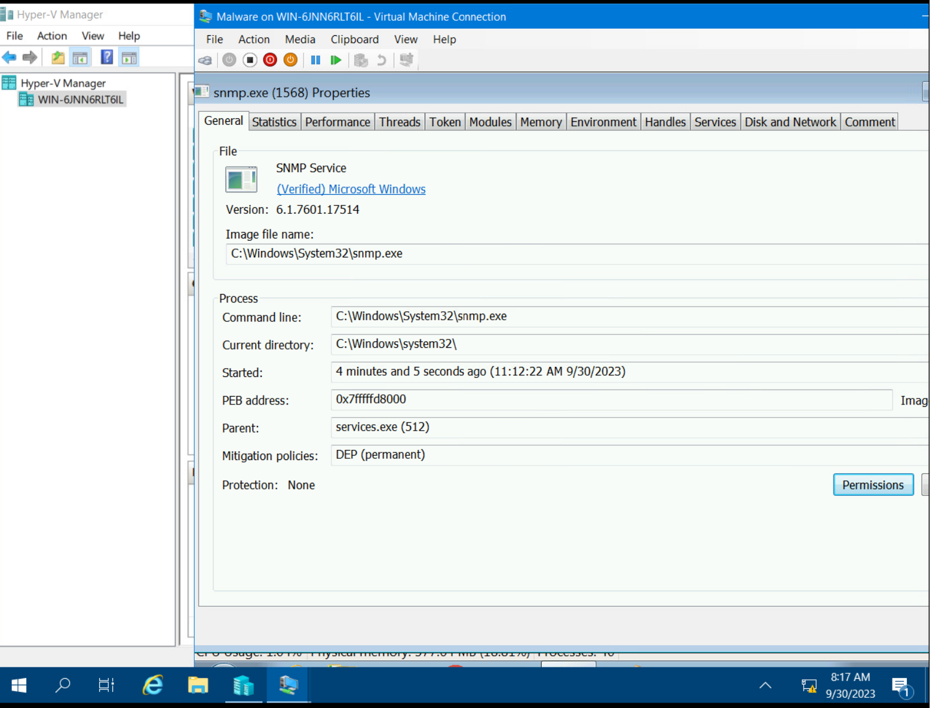
Process Hacker
Take a screenshot of the output in Part 2, Step 5.
It should show properties of a chosen process.

Slide 18
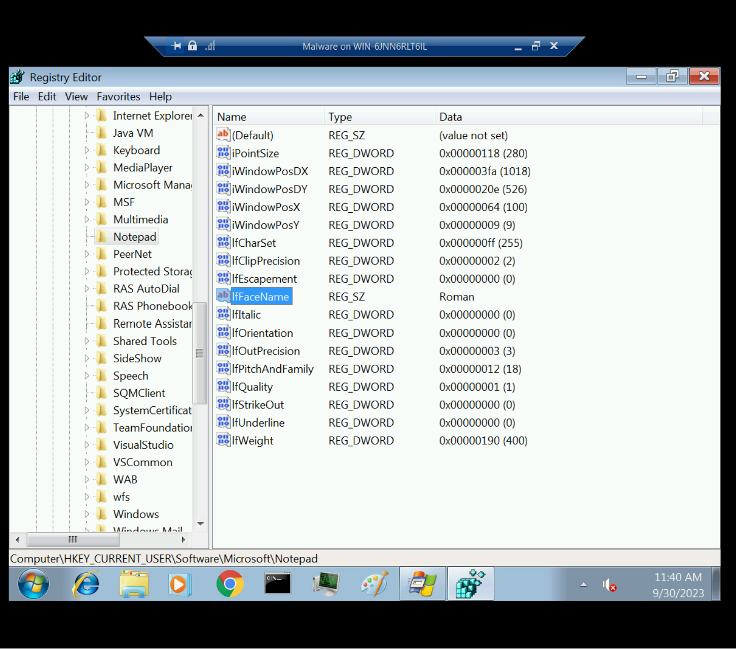
Process Monitor
Take a screenshot of the output in Part 3, Step 13.
It should show ifFaceName in the Path column and Data: Roman in the Detail column.

Slide 19

References
… DeVry video tutorial
… Introduction to Memory Forensics - Digital Forensics Course – YouTube

Slide 20

Module 6 Firewall

Slide 21
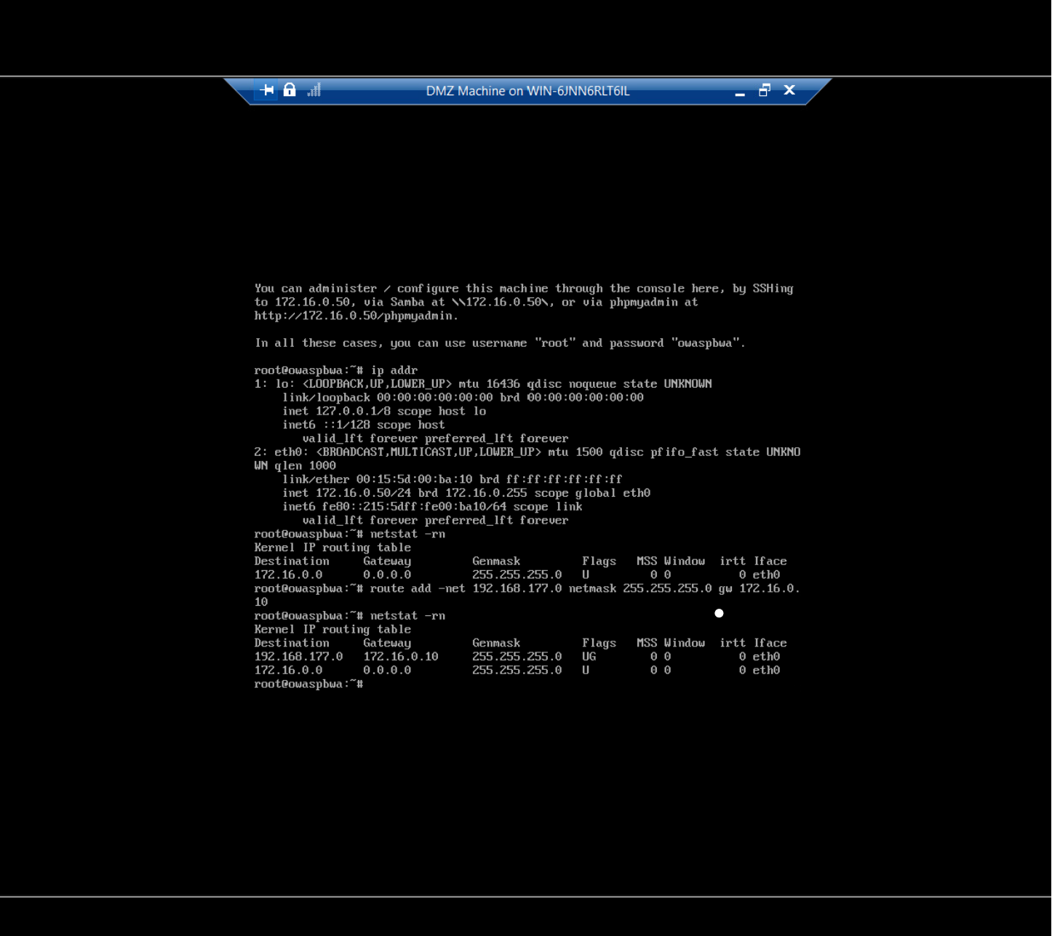
Time-based Access
Take a screenshot of the output in Part 1 Step 21.
It should show the output of the DMZ Route Table.

Slide 22
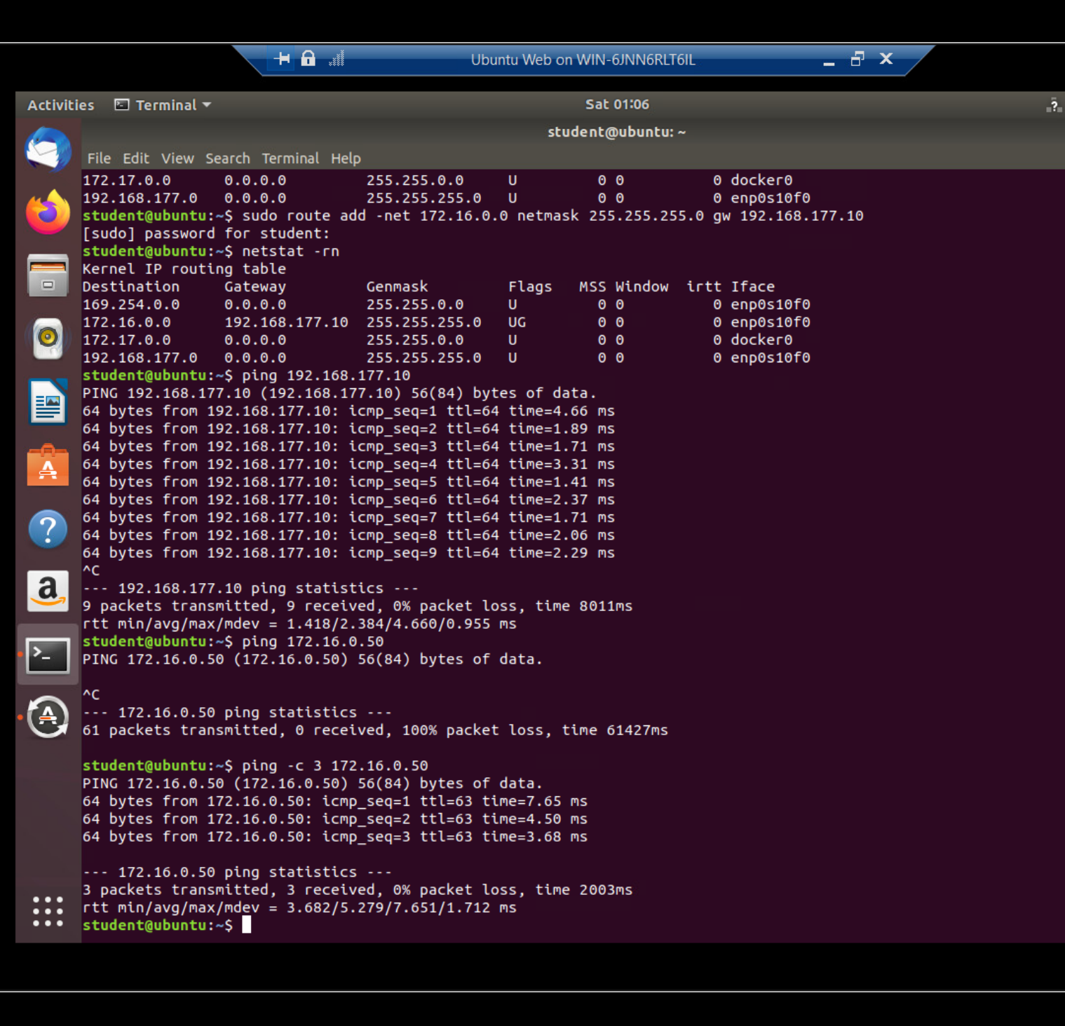
Time-based Access
Take a screenshot of the output in Part 1 Step 26.
It should show a successful ping from the Ubuntu Web VM and the DMZ VM.

Slide 23
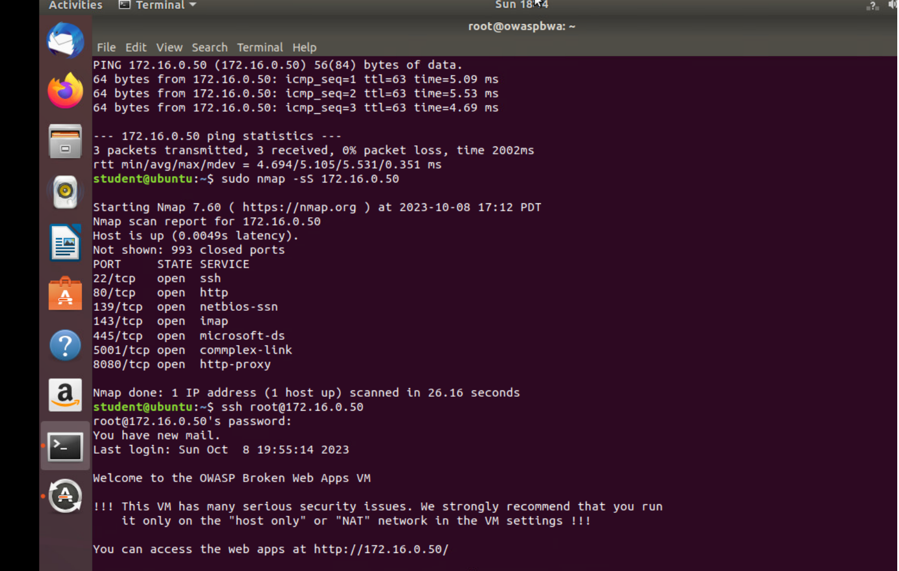
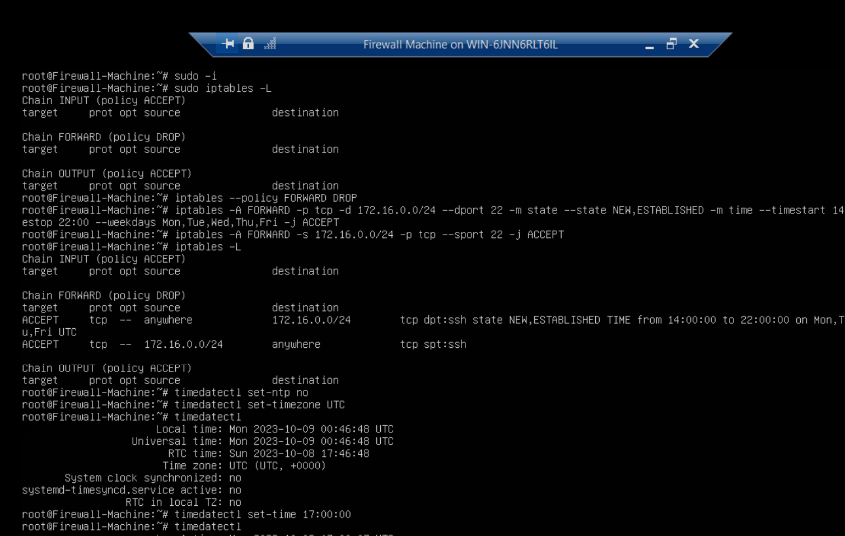
Time-based Access
Take a screenshot of the output in Part 1 Step 34.
It should show two time-based access rules in the FORWARD chain

Slide 24
References
… Next-Gen Firewalls & Topologies. Designing & Building DMZs. Concepts, Best Practices & Tips
… Module 6: Project - Firewall (instructure.com)

Slide 25
Challenges Faced
I faced a challenge with the module 2 project. Some of the problems that I faced were trying to figure out the differences between both ICMP packets for this project.

Slide 26
Career Skills
Some career skills that I learned are patience, time management, understanding of material better, & Attention to detail as it is super important in the IT field.

Slide 27
Conclusion
In conclusion I learned about Intrusion analysis using wireshark, open SSL, SNORT, Live memory analysis, & Firewall. While being in this class I had minor challenges but learned to go back and re-check your work for better accuracy, have a bit more patience, and have a good sense of time management. I hope this presentation gives you a good insight of everything I have learned.

Slide 28
Thank you

